Slide 1

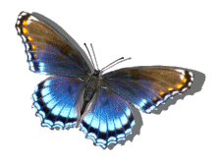


Slide 2
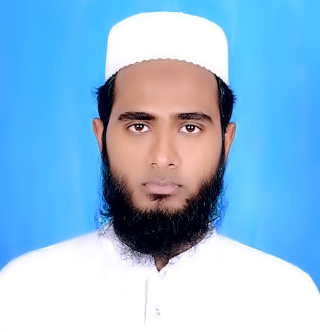
Introduction
Md. Rafiqul Islam Masum
B.Sc (Hon’s), M.Sc(Physics), P.G.D.T.E, C-in Ed
Assistant teacher
Pubargown Govt. Primary School
Shibpur, Narsingdi.

Slide 3
Class-3
Subject-English
Unit-19 :Occupation
Lesson-1
Page no-38

Slide 4
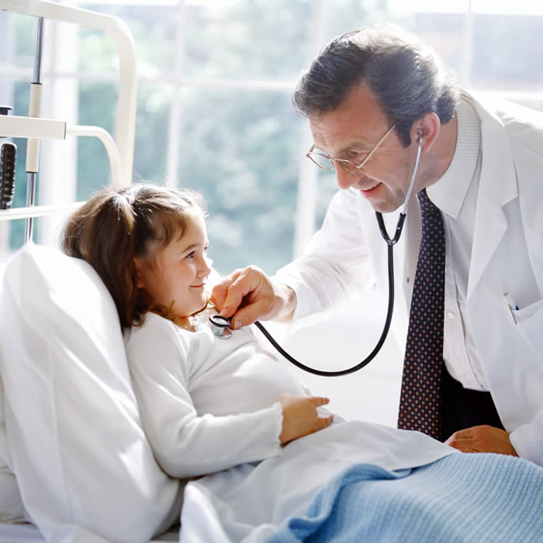
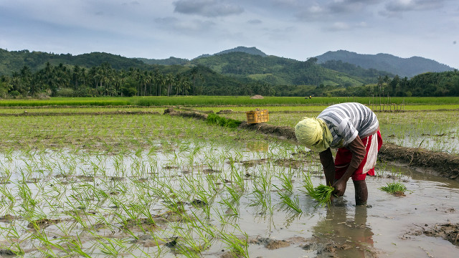
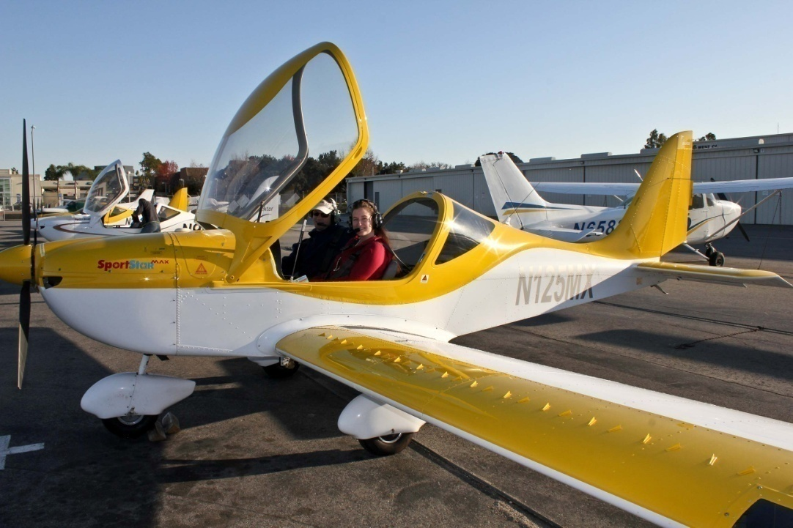
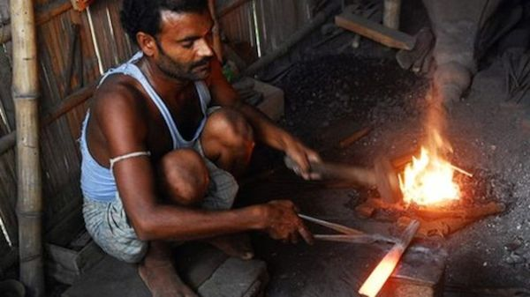

Slide 5
Lesson- Occupations

Slide 6
Learning outcomes:
Students will be able to-
Speaking:
1.1.1 repeat word, phrases and sentences after the teacher with proper sound and stress.
 1.1.2 say words, phrases and sentence after the teacher with proper sound and stress
 6.2.1 talk about people and objects.
Writing:
 3.1.2 to write words, phrase and sentences using non-cursive small letters.

Slide 7
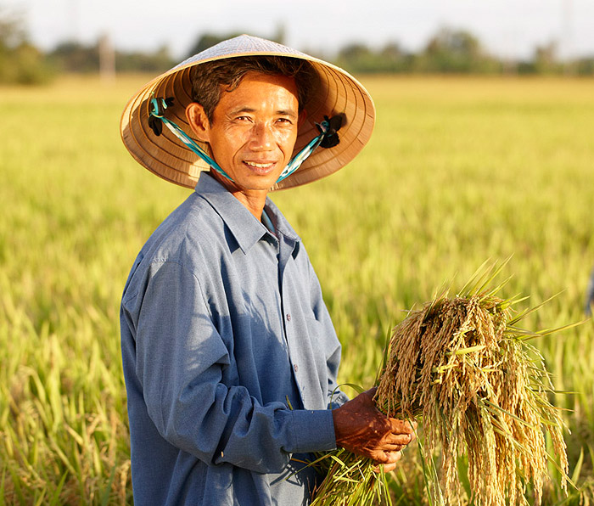
A farmer

Slide 8
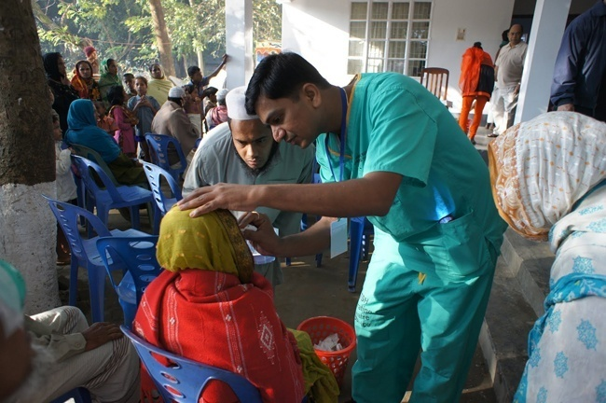
A doctor

Slide 9
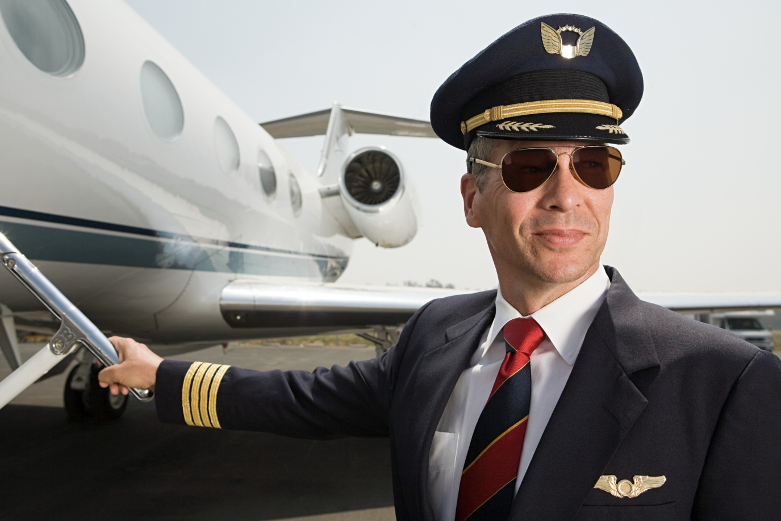
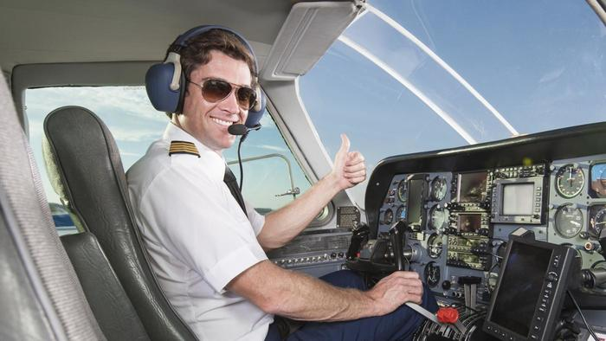
A pilot

Slide 10
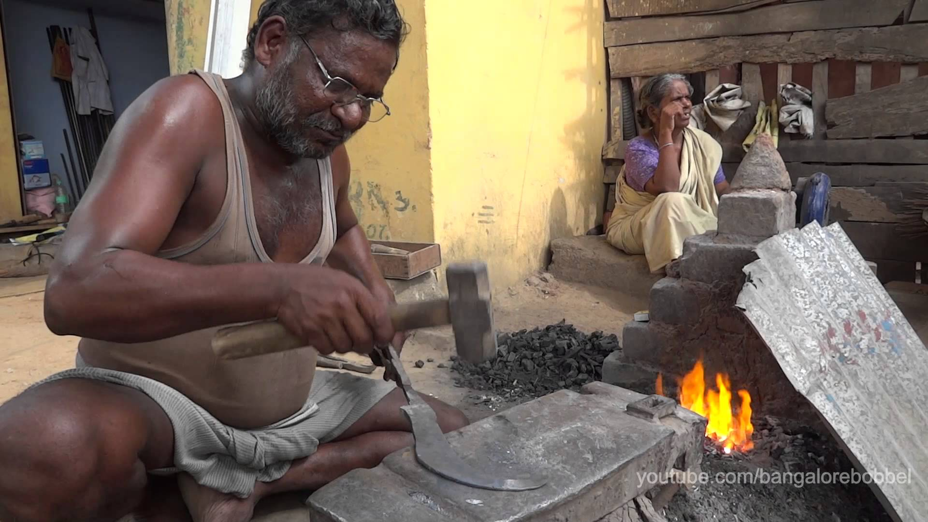
A blacksmith

Slide 11
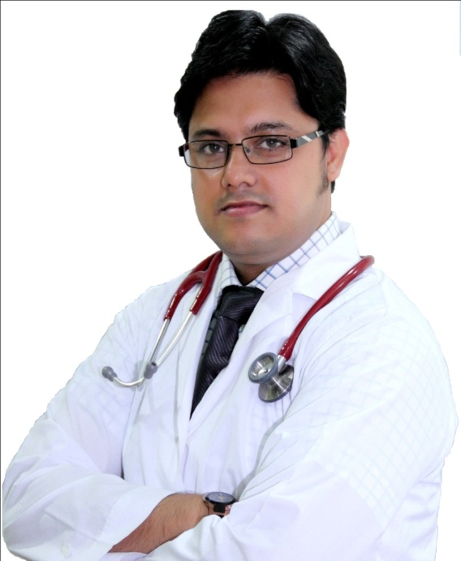


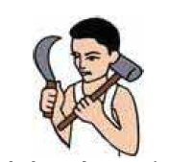
Farmer
Doctor
Blacksmith
Pilot

Slide 12



Group work
Group A | Group B
One Student read the word loudly and other will be repeat & by turn | One Student read the word loudly and other will be repeat & by turn
Farmer
Doctor
Pilot
Blacksmith

Slide 13
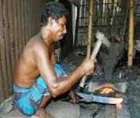
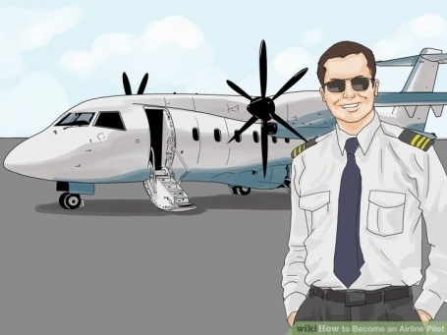

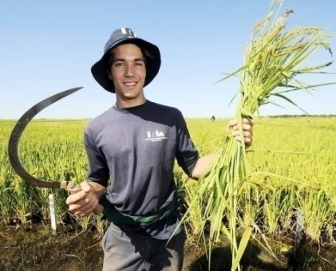
Group work
Group A | Group B
Write the name of their occupation | Write the name of their occupation
Blacksmith
Pilot
Doctor
Farmer

Slide 14


Everybody open your book at page no. 38
Now write the letter (from Lesson A) and sentences using non-cursive small letters.

Slide 15

What’s his occupation ?
Blacksmith
Who is he ?
Doctor

Slide 16
Write their occupations (Individual)
1. …………
2. …………
3. …………

Slide 17
Who drive aeroplane?
1. Farmer
2. Doctor
3. Pilot
4. Blacksmith
Who grows crops?
Doctor
Pilot
Farmer
Blacksmith

Slide 18
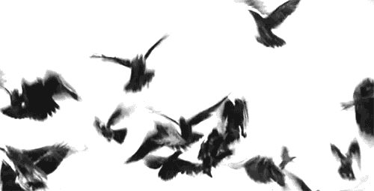
The End

